Slide 1
Overfitting, Underfitting, Generalization

Slide 2
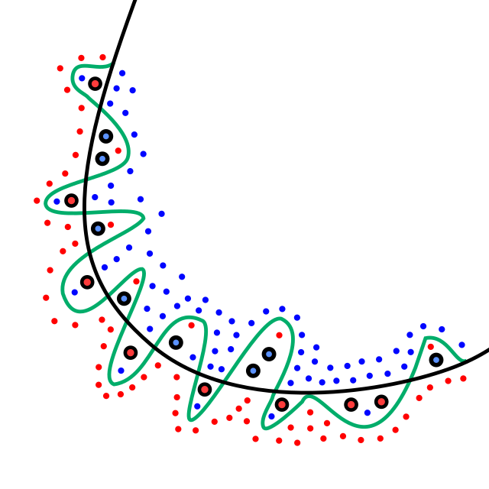
Overfitting
Overfitting occurs when a machine learning model learns the training data too well, capturing noise and minor details that do not generalize to new, unseen data. It results in high accuracy on training data but poor performance on test data.
How to Detect Overfitting?
Training vs. Test Performance: If training accuracy is very high while test accuracy is much lower, it indicates overfitting.
High Variance: A large gap between training and validation loss/accuracy suggests the model is memorizing rather than generalizing.
Cross-validation: If performance varies significantly across different validation sets, the model might be overfitting.
How to Overcome Overfitting?
More Data: Adding more training samples can help the model learn more generalized patterns.
Regularization: Use techniques like L1 (Lasso) or L2 (Ridge) regularization to penalize large weights.
Dropout: In neural networks, dropout randomly disables neurons during training to reduce dependency on specific features.
Early Stopping: Monitor validation loss and stop training when performance starts degrading.
Data Augmentation: Apply transformations (e.g., rotation, scaling) to artificially increase the dataset.
Simpler Model: Reduce model complexity by using fewer layers, parameters, or smaller trees in decision trees.

Slide 3
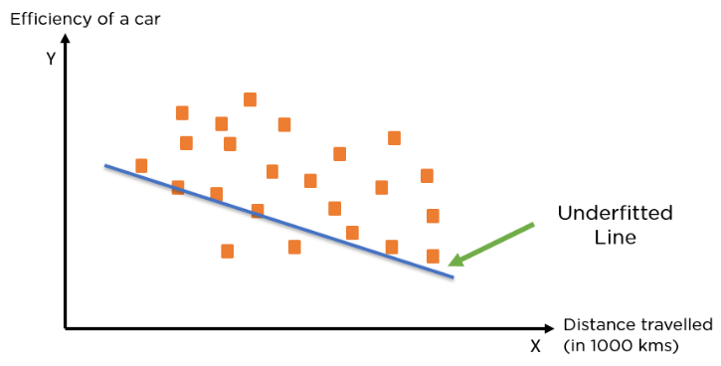
Underfitting
Underfitting happens when a model is too simple to learn the underlying structure of the data. It performs poorly on both training and test data.
How to Detect Underfitting?
Low Training and Test Accuracy: The model performs poorly on both sets, indicating it hasn’t learned enough patterns.
High Bias: The model makes overly simplistic predictions that don’t capture the complexity of the data.
How to Overcome Underfitting?
Increase Model Complexity: Use a deeper neural network, more features, or more complex algorithms.
Reduce Regularization: If regularization is too strong, it may restrict the model too much.
Train Longer: Allow the model to train for more epochs to learn better representations.
Feature Engineering: Add more relevant features to give the model more information.

Slide 4
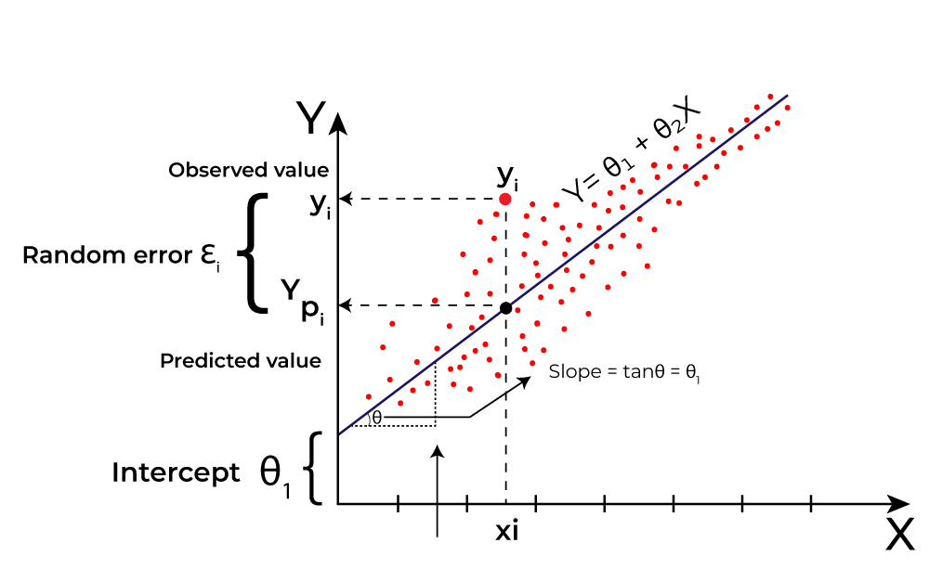
Generalization
Generalization refers to a model’s ability to perform well on unseen data. A well-generalized model strikes a balance between underfitting and overfitting, capturing patterns without memorizing noise.
How to Ensure Good Generalization?
Balanced Model Complexity: Choose a model complex enough to capture patterns but not too complex to memorize noise.
Proper Data Splitting: Use train-validation-test splits and cross-validation.
Regularization Techniques: Use dropout, L1/L2 regularization, and early stopping.
Diverse Data: Train on varied and representative data to make the model robust.
Hyperparameter Tuning: Optimize hyperparameters (learning rate, depth of trees, etc.) using validation data.

